Slide 1
How to Administer Search in SharePoint Online
Speaker Name

Slide 3
Objectives
This lesson introduces the search experiences that are available in SharePoint Online, and how to configure and administrator each of them.
Learn about the search experiences that are available in SharePoint Online
Gain understanding of the differences between these two search experiences
Gain understanding of the configuration and administration settings for each search experience

Slide 4
Search Experiences in SharePoint Online

Slide 5
Search experiences in SPO
SharePoint in Microsoft 365 has both a classic and a modern search experience
Microsoft Search in SharePoint Online is the modern search experience
Both search experiences use the same search index to find results.
A Search admin can customize the classic search experience, but not the Microsoft Search experience
Certain aspects of the classic search settings also impact the modern search experience
You use the SharePoint admin center to manage classic search and the Microsoft 365 admin center to manage Microsoft Search.
Microsoft recommends to only switch an only use Microsoft Search

Slide 6

Search experiences in SPO
The search schema determines how content is collected in and retrieved from the search index.
Both search experiences use the same search index to find search results, so changes you make to the search schema, apply to both experiences.
The modern search experience only shows results from the default result source. If you change the default result source, both search experiences are impacted.
If you temporarily remove a search result, the result is removed in both search experiences.
The classic search experience lets admins define promoted results to help users find important content, while the Microsoft Search experience uses bookmarks to achieve the same.

Slide 7
Microsoft Search configuration

Slide 8
Microsoft Search experience
Uses the insights of the Microsoft Graph to show results that are relevant to the user.
Each user might see different results, even if they search for the same words.
Users get the Microsoft Search experience on the SharePoint start page, hub sites, communication sites, and modern team sites, and also within Office applications
Users get results that are relevant in the context of the app they search from. For example, when they search in Microsoft Outlook, they find emails, and not SharePoint sites. When they search in SharePoint, they find sites, pages, and files.

Slide 9
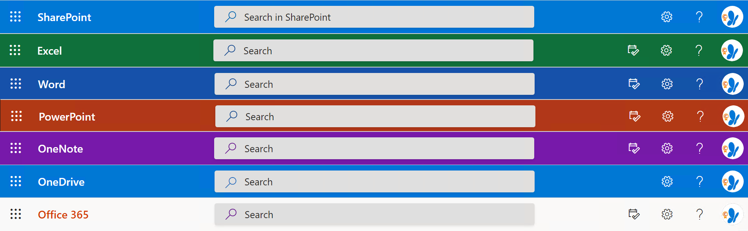
Microsoft Search experience in apps
In the Office apps, users find the Microsoft Search box in the header bar.

Slide 10
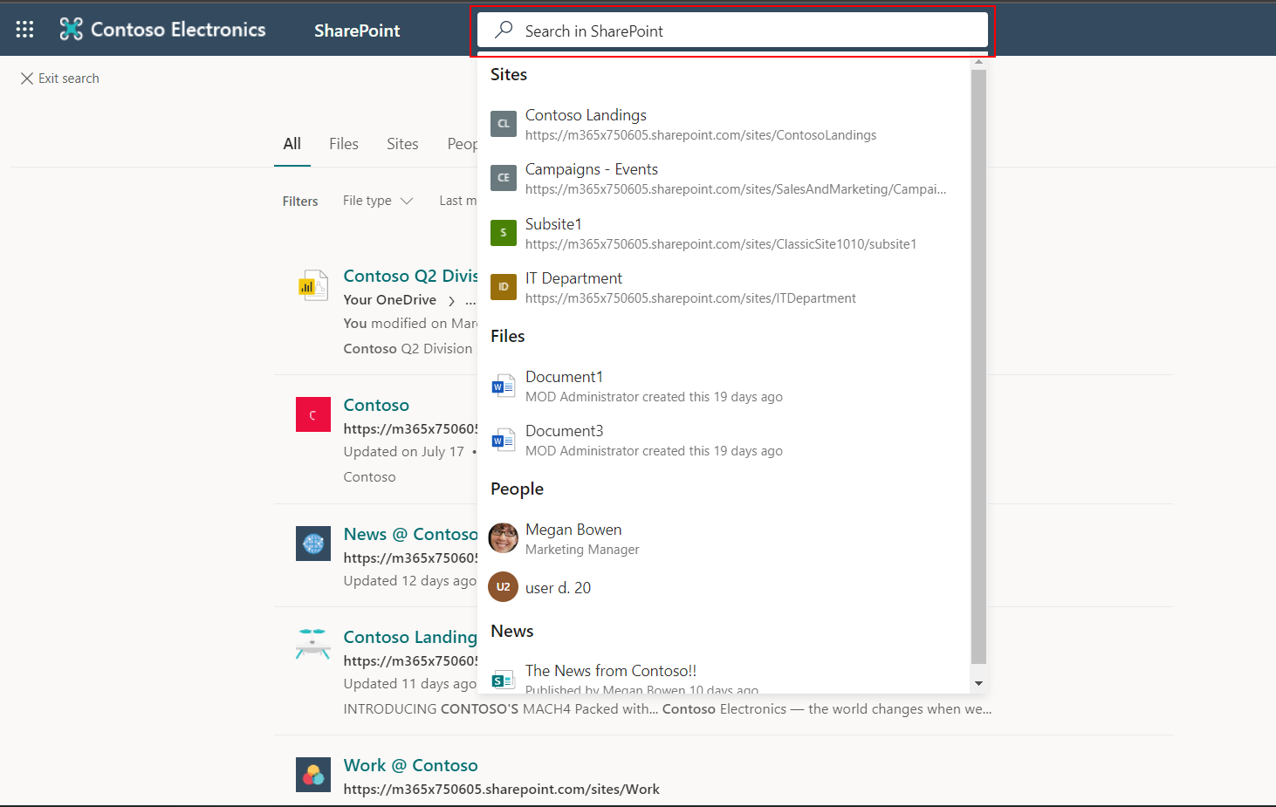
Microsoft Search experience in SharePoint start page

Slide 11
Benefits of Microsoft Search
Search across Microsoft 365 from any Microsoft Search box
Easy to search – Microsoft Search suggests results based on users’ previous activity in Microsoft 365, right in the Search box
Find shared files – Microsoft Search uses advanced query understanding to make finding shared files simple. Users can easily find files they’re collaborating on.
Show relevant content – Promote the information and answers your users need to complete tasks, for example policies, benefits, resources, tools, and more.
Administer across all apps – Microsoft Search is on by default and any administration you do applies to Microsoft Search in all the apps.

Slide 12
Modern Search Admin roles
Search admin: Full access to Microsoft Search, assigns the Search Administrator and Search Editor roles, manages editorial content, monitors service health, and creates service requests.
Search editor: Can only create, edit, and delete content for Microsoft Search, like bookmarks, Q&A, and locations.
Notes:
Search administrators directly influence the search experience for end users. This includes choosing the types of results you want to surface to your users. It may be difficult for one person to choose and create authoritative content on many different topics that users search for in an organization. We recommend that you leverage the expertise and knowledge of subject matter experts (SME) and other users by adding them as Search editors.

Slide 13
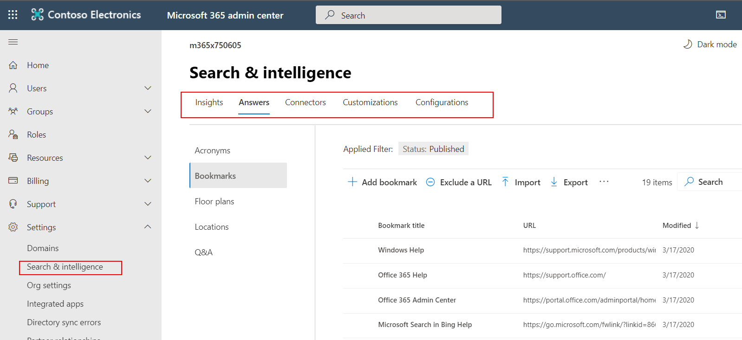
Microsoft Search admin configuration settings

Slide 14
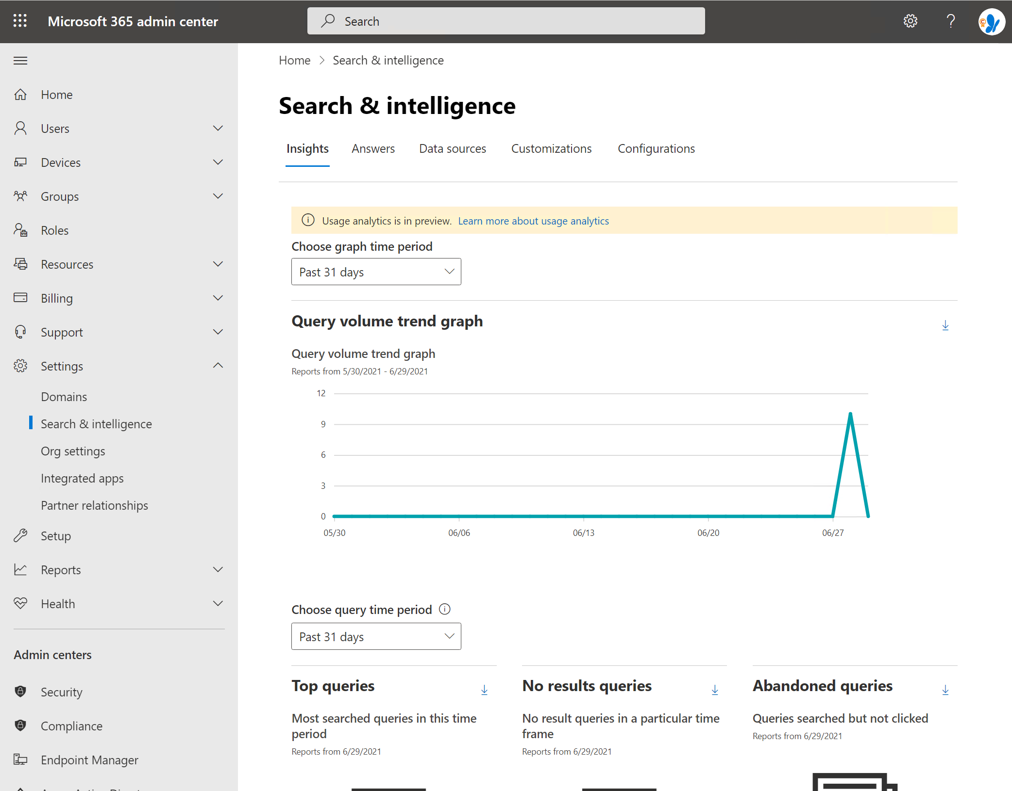
Insights
The Microsoft Search usage reports include graphs and tables generated from searches that are executed from SharePoint Home and Office.com search boxes. You can see data from the past 31 days, per day, or monthly for the previous year.
Notes:
Report Description
Query Volume - This report shows the number of search queries performed. Use this report to identify search query volume trends and to determine periods of high and low search activity.
Top Queries - This report shows the most popular search queries. Use this report to understand what types of information your users are searching for.
Abandoned Queries - This report shows popular search queries that receive low click-through. Use this report to identify search queries that might create user dissatisfaction and to improve the discoverability of content. You can then determine if creating an answer, like a Bookmark, or ingesting new content through a Graph connector is the right action.
No Results Queries - This report shows popular search queries that returned no results. Use this report to identify search queries that might create user dissatisfaction and to improve the discoverability of content. You can then determine if creating an answer, like a Bookmark, or ingesting new content through a Graph connector is the right action.

Slide 15
Answers
Acronyms
Set up editorial acronyms on the Acronyms tab in the Microsoft Search admin center. Admins can add acronyms individually or bulk import them in a CSV file.
Bookmarks
Bookmarks help people quickly find important sites and tools with just a search. Each bookmark includes a title, URL, a set of user-friendly keywords to trigger the bookmark, and a category.
Floor plans
Floor plans in Microsoft Search help users find people and meeting rooms within a building. Floor plans files must be in DWG format
Locations
Location helps your users find addresses and locate your organization's buildings by providing an accurate location for offices, campuses, and buildings, along with directions and navigation. Administrators should add all important locations of your organization.
Q&A
Creating a Q&A is like creating bookmarks. Q&As allow you to answer the user's questions instead of just providing a link to a webpage.
Notes:
You can add acronyms from any internal site or repository to the admin center. Editorial acronyms can be added to Published or Draft state:
Published state. Acronyms are available to the organization’s employees through Microsoft Search.
Note
It might take up to three days for acronyms added to Published state to become available in Microsoft Search.
Draft state. If admins want to review Acronyms answers before making them available in Microsoft Search, they can add the acronyms to Draft state. Acronyms added to Draft state aren’t available in Microsoft Search. Admins need to add the acronyms to Published state to make them available.
Mined acronyms
It might be a challenge for admins to add all the acronyms used within an organization to Answers. This feature can find acronyms that search administrators aren’t even aware of. To do that work, Microsoft Search also mines acronyms from these sources:
Users’ emails.
Documents in SharePoint, Microsoft OneDrive, and Microsoft OneNote.
Public documents within the organization that users have access to in SharePoint, OneDrive, or OneNote.
Microsoft Search makes sure that only users with access and permissions to a document can see the acronyms that are mined from it. When an acronym is mined from a user's mailbox, only that user can see that acronym.
Note
No setup is needed for mined acronyms.

Slide 16
Connectors
Microsoft Search indexes all your Microsoft 365 data to make it searchable for users.
With Microsoft Graph connectors, your organization can index third-party data so it appears in Microsoft Search results.
This expands the types of content sources that are searchable in your Microsoft 365 productivity apps and the broader Microsoft ecosystem.
The third-party data can be hosted on-premises or in the public or private clouds.
Notes:
Graph connectors by Microsoft
You can connect to the following data sources using Graph connectors created by Microsoft:
Azure Data Lake Storage Gen2
Azure DevOps
Azure SQL
Enterprise websites
MediaWiki
Microsoft SQL Server
File share
Oracle (preview)
Salesforce (preview)
ServiceNow
The Graph connectors gallery contains a brief description of each of these Graph connectors. If you are ready to connect one of these data sources to your tenant, be sure to read the Setup overview and any other articles in the Setup connectors by Microsoft section that apply to your data source.
Graph connectors by our partners
The Microsoft Graph connectors gallery includes a brief descriptions of each of the Graph connectors created by our partners and a link to each partner's website. Contact each partner directly to learn more.

Slide 17
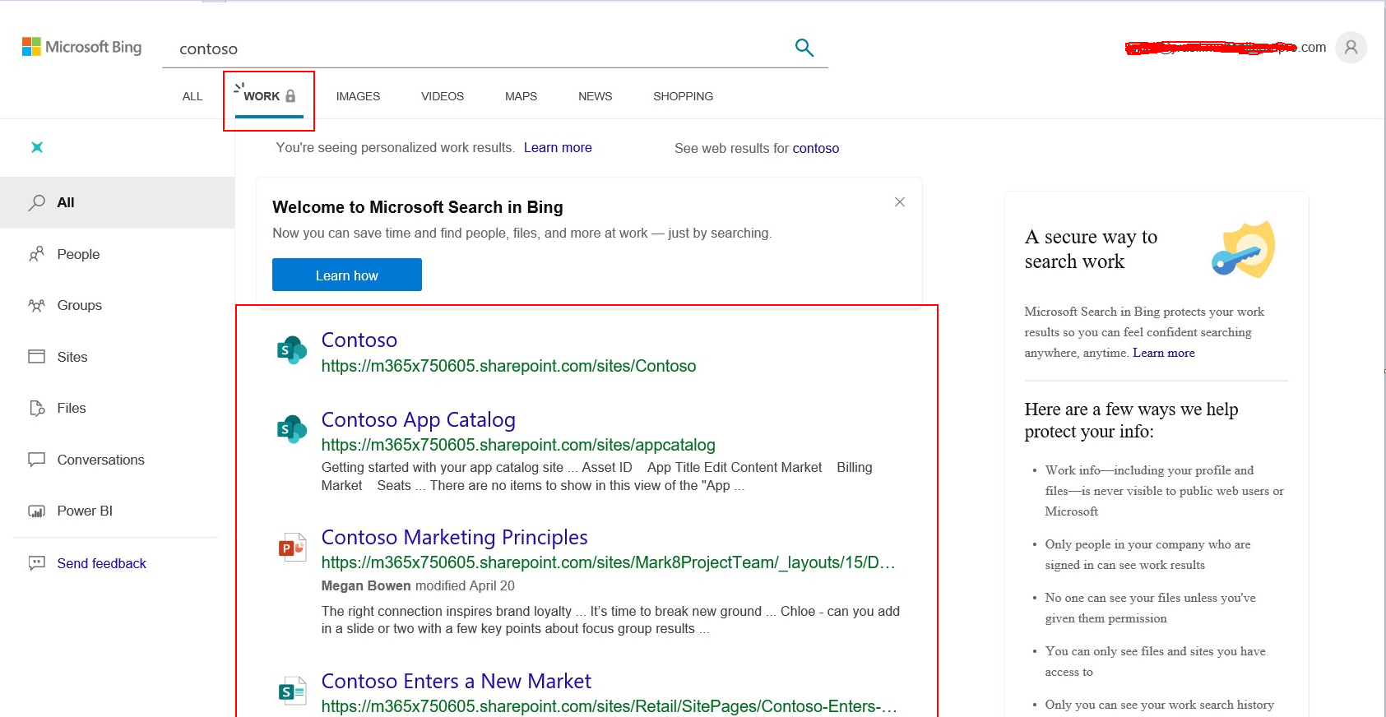
Configurations- Microsoft Search in Bing
If enabled, Microsoft Search in Bing allows your users to use the familiar browser address bar and search box in Bing.com to find workplace information more easily.
Microsoft Search in Bing searches across files, SharePoint sites, OneDrive content, Teams and Yammer conversations, and other shared data sources in your organization, as well as the web.

Slide 18
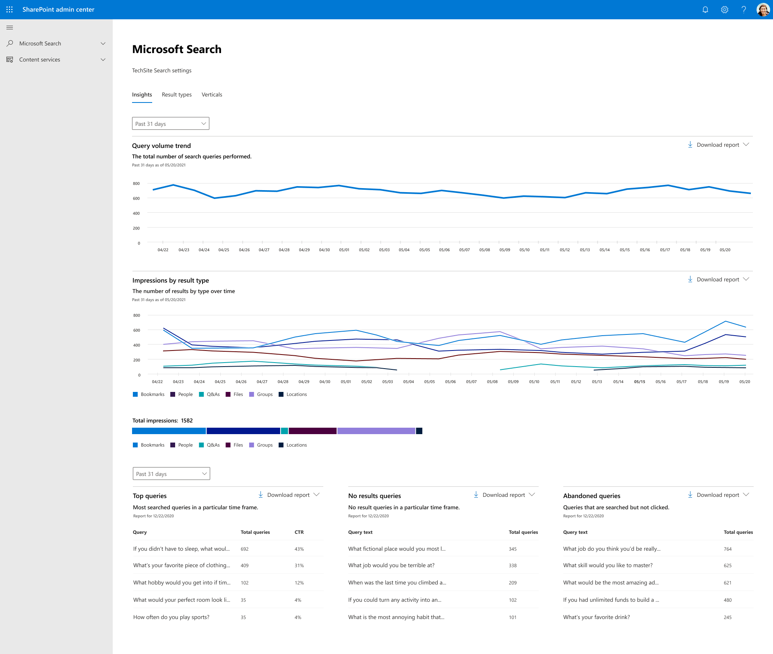
View search usage reports in modern sites
To view search usage reports in modern sites, navigate to Site settings > Site collection administration > Microsoft Search > Configure search settings > Insights.

Slide 19
Microsoft Search Administration
Creating Bookmarks
Creating Acronyms

